Slide 1
Data Type and Operators

Slide 2
Introduction
All the data are stored in the form of basic memory units called bits.
A bit is a unit of memory that has only two possible states 0 & 1
The smallest memory unit is 1 byte. (8 bits )

Slide 3
Data Type
The data type defines which kinds of data will be stored in variables
And also define how many memory used for the data

Slide 4
Data Type

Slide 5
C++ Data types
Data type is used to tell the computer
Type of data
Size of memory used for store the data
Classified into 3
Built in data type (Fundamental Data type)
Derived data type
User defined data type

Slide 6
Data types
Built in data type
Char (1 byte)
Int (2 byte)
Float (4 byte)
Double (8 byte)
Void (0 byte)
Derived data type
User defined data type

Slide 7
Data types
Built in data type
Derived data type
Array
Pointer
Functions
reference
User defined data type

Slide 8
Data types
Built in data type
Derived data type
User defined data type
structure
union
class
enumeration

Slide 9
Built-in / Fundamental Data type
 | Data type | Memory size
Character : | char | 1 byte
Integer : | int | 2 byte
Floating point : | float | 4 byte
Double floating point : | double | 8 byte
Valueless : | void | ____

Slide 10
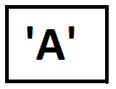
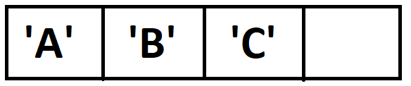
Character ( char )
used to store a character value. ( letters )
Character literals are written in single quotes, like this: 'A'
for multiple characters ( strings ) use double quotes: "ABC“
Example:
char x=‘A’;
char x=“ABC”;
X
1 byte
X
1 byte
1 byte
1 byte
1 byte

Slide 11
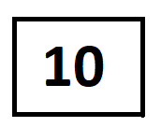
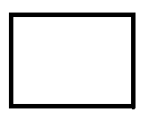
Integer ( int )
used to store an integer value. ( numbers )
Not store fractional part
Example:
int x=10;
int count = 0;
X
2 byte
0
count
2 byte

Slide 12
Floating point ( float )
used to store an floating point value. ( real numbers )
store fractional part
Example:
float x=10.5;
float pi = 3.14;
10.5
X
4 byte
3.14
pi
4 byte

Slide 13
Double
used to store an floating point value. ( real numbers )
store fractional part
Double memory of float type
Example:
double x=10.5071;
double mark = 20;
10.5071
X
8 byte
20.0000
mark
8 byte

Slide 14
Void
used only in function declarations
Use zero byte memory
Example:
void main()
void read()
void display()

Slide 16
Variable,Constant,Expression

Slide 17
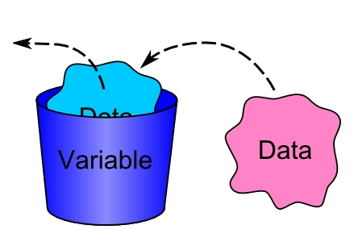
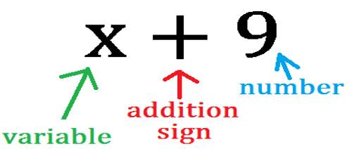
Identifiers (Variables)
A variable is a letter or symbol used to represent a value that can change
The value may be number or characters ..

Slide 18
Identifiers (Variables) naming rules
Only alphabetic characters (A-Z), digits (0-9) and underscore (_)are permitted
Name cannot start with digit
Uppercase(A-Z) and lowercase(a-z) are distinct
Keywords cannot be used as variables
Example :
int a = 50; _Name
float mark = 26.7; _Num5
void _display() num5

Slide 19
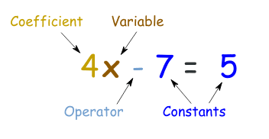

Constants
A Constant is a value that does not change
Ex: 5,0,3.14,

Slide 20
Expressions
Expression is a sequence of operators and their operands that specifies a process or computation
Example :
c = a + b;
avg = sum / total_num ;
Operands
c = a + b ;
Operator
Expression

Slide 21
Statements
Smallest executable unit of a program
All statement end with semicolon (;)
Declaration statement
Variables are must be declare before using it.
Example : int a;
int x, y, z;
Assignment statement
Assign the value of RHS to LHS
Example : Age = 18 ;
int x = 10, y = 5 ;

Slide 23
Operators

Slide 24
Operators
It is a symbol that performs an operation
The meaning of the symbols are already defined in the C++ Compiler
The data in an operation is called operands
Operands
a + b
Operator
Operation

Slide 25
Operators are…
Input/Output Operators
Arithmetic Operators
Relational Operators
Logical Operators
Conditional Operators
Assignment Operators
Increment & decrement Operators
SizeOf Operators

Slide 26
Input / Output Operators
Used to perform Input / output operations
Operator | Description | Example
>> | Input | cout << “Hello world”
<< | Output | cin >> mark

Slide 27
Arithmetic Operators
Operator | Description | Example
+ | Addition | x + y
– | Subtraction | x – y
* | Multiplication | x * y
/ | Division | x / y
% | Modulo | x % y

Slide 28
Relational Operators
Operator | Description | Example
== | Equal to | x == y
!= | Not equal to | x != y
< | Less than | x < y
> | Greater than | x > y
<= | Less than or equal to | x <= y
>= | Greater than or equal to | x >= y

Slide 29
Logical Operators
Operator | Description | Example
&& | Logical AND | x && y
|| | Logical OR | x || y
! | Logical NOT | !x
Logical NOT : Unary operator

Slide 30
Conditional Operators
It is a ternary Operator
Operator | Example
? : | (A == 10) ? A++ : A-- ;
(N == 10) ?
cout << “Number is 10” : cout << “Number is not 10” ;

Slide 31
Assignment Operators
x = y
x = 5
5 = x
Operator | Description | Example
= | Assignment | x = y
+= | Add & assign | x += y
–= | Subtract & assign | x –= y
*= | Multiply & assign | x *= y
/= | Division & assign | x /= y

Slide 32
Increment & Decrement Operators
Operator | Description | Example
++ | Increment | X ++
– – | Decrement | Y – –
Unary operator
x = x + 1 x += 1 x ++
x = x – 1 x –= 1 x – –

Slide 33
SizeOf Operators
Used to find the size of a data type
Example :
sizeof(int);
sizeof (float)

Slide 34
Type Conversion

Slide 35
Type Conversion
Data are converted from one type to another type are called type conversion
Classified into 2
Implicit type conversion
Explicit type conversion

Slide 36
Implicit Type Conversion
It is automatically done by the compiler.
For example ,
float N = 5; → 5 is an integer type, float 5 is implicitly
converted into 5.0000
int N = 6.54 ; → 6.54 is a float type, int 6.54 is implicitly
converted into 5
int N = 4.5;
int N = 4;
implicitly converted

Slide 37
Explicit Type Conversion
It is done by the program code.
For example ,
int N = 10;
Int X = 4;
float S = (float) N / X
Data Type tell the compiler how to transfer it

Slide 38
Structure of C++ program

Slide 39
// Command line
# include < Header File >
using namespace std;
int main()
{
………………….
………………….
………………….
}
Body of the program

Slide 40
Teaching materials Prepared by
RIDHUN DEV
Lecture IHRD College
+1 / +2 Computer Science
8089552581

